Slide 1
Earth Grant Internship Demo
Jose Garcia
UArizona Compost Cats

Slide 2
Leadership Role within Compost Cats
Project Lead for Foodcycle Program, a commercial composting service for Tucson businesses.
Scheduling food waste audits, managing customer relations, attending meetings with city partners.
Aid in the organization and expansion of the program, through the creation, development and completion of the following tasks.

Slide 3
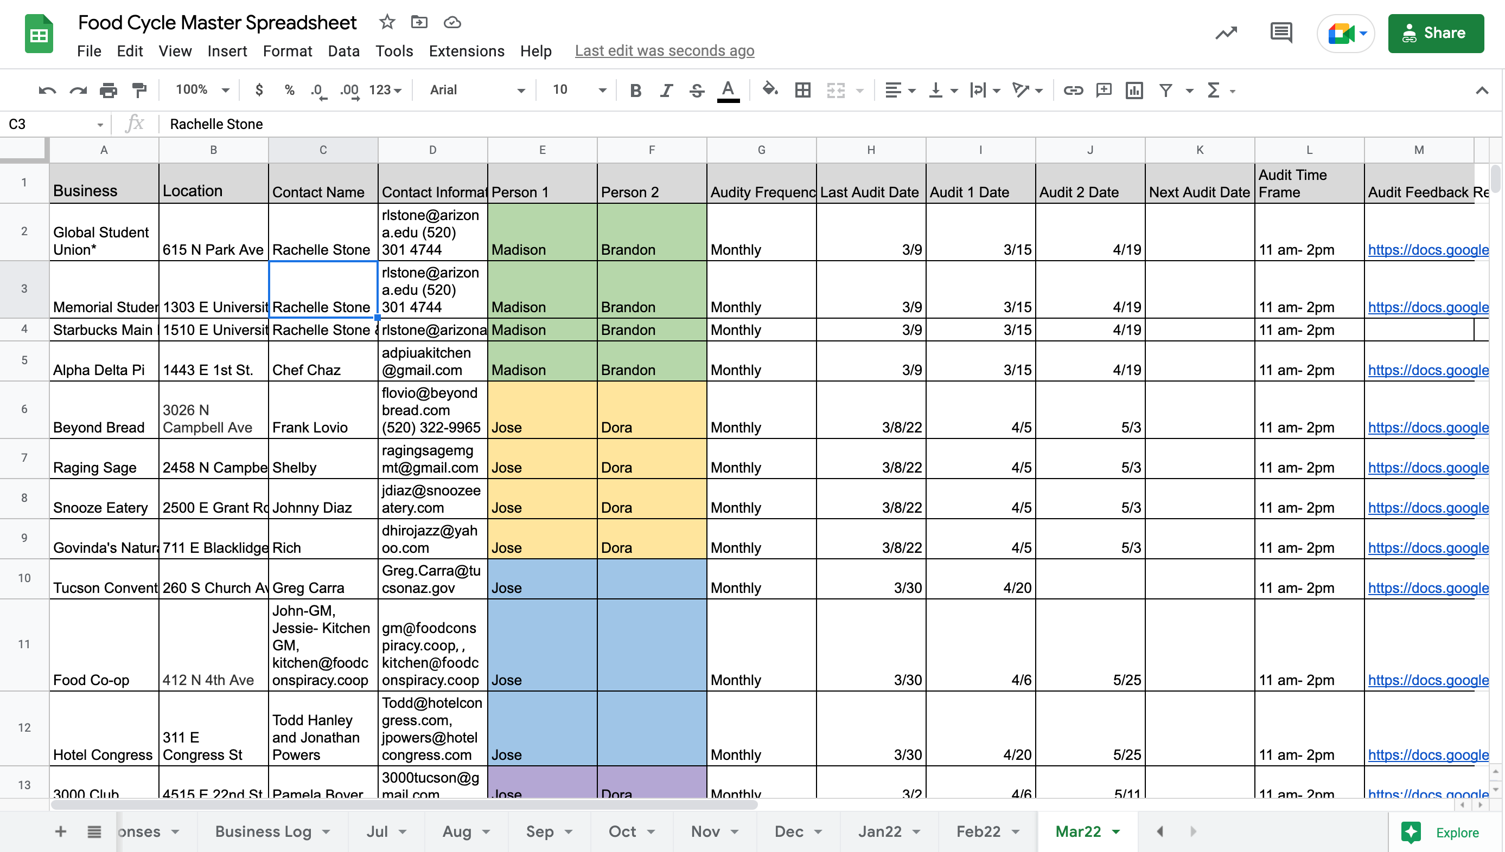
Monthly scheduling of Food Waste audits.
Managing email communications between businesses.
Data collection and logging.

Slide 4
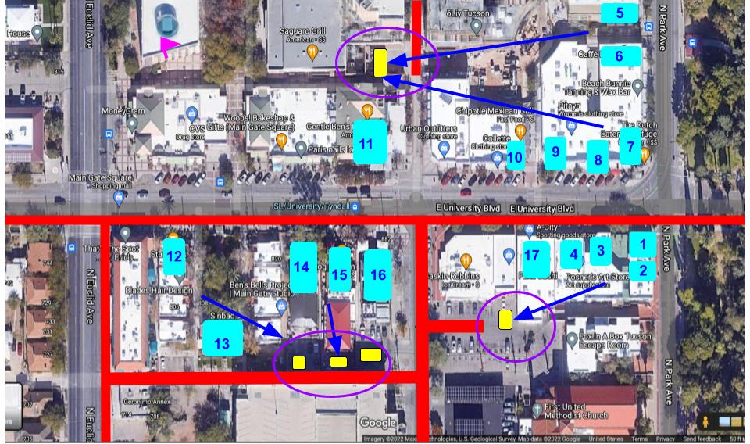
University Blvd. New Business Assessment

Slide 5
Cont.
Assessment of 17 food/beverage establishments on University Blvd.
Struck conversations about waste management and food waste production and determining interest in the Food Cycle Program.
Done through door-to-door outreach.
Businesses such as: Scented Leaf, Panera, Fuku Sushi, Gentle Bens, Sinbad, Chipotle, Jimmy Johns, The Dutch and others.
This assessment resulted with a recommendation for 5 businesses to join the Food Cycle Program.

Slide 6
Los Reales Compost Facility

Slide 7
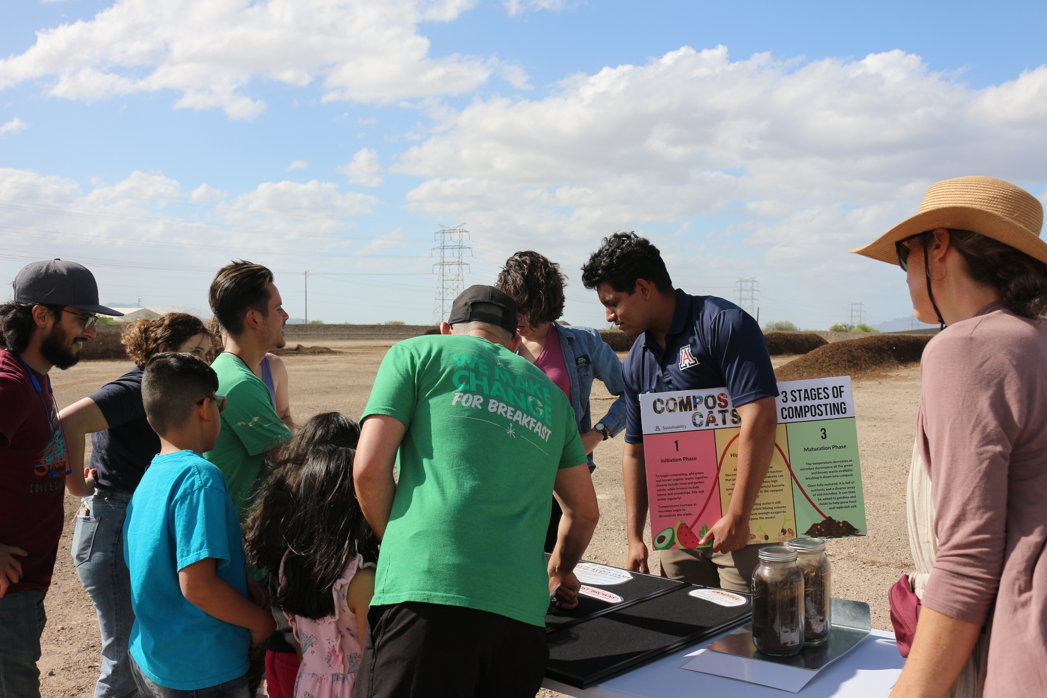
Compost Facility Education Tour
Compost education tour for a Food Cycle program participant.
Understanding of how the backend of the program works and gaining new knowledge about compost systems and preventing contamination.
First of many more tours to be held at the compost facility.

