Slide 1
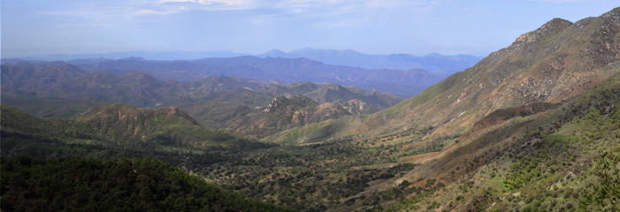
Earth Grant 2022 Sky Island Alliance
Micah Kaufmann

Slide 2
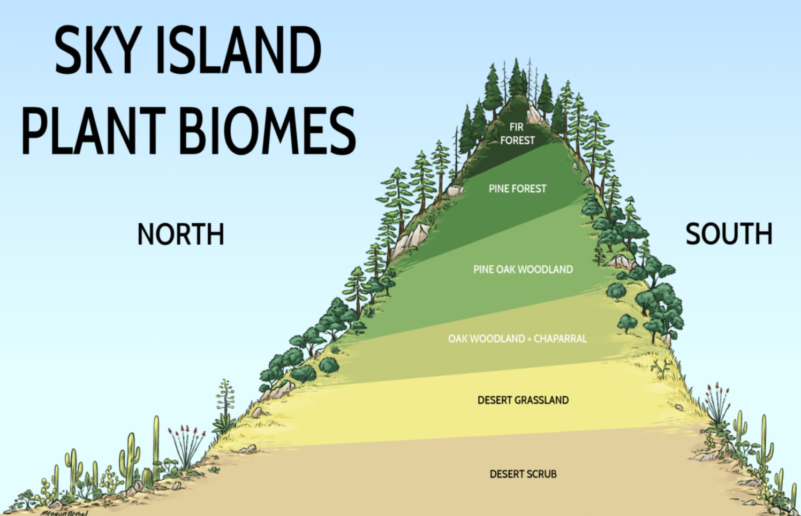
Sky Island Region
Otherwise known as the Madrean Peninsula, the Sky Islands are a series of isolated mountains separated by "seas" of grassy lowlands. The differences in elevation create various biomes which allow for vertical migration of species.
This is a unique area for high biodiversity, and it hosts rare and endangered animals such as the jaguar – see next slide.

Slide 3
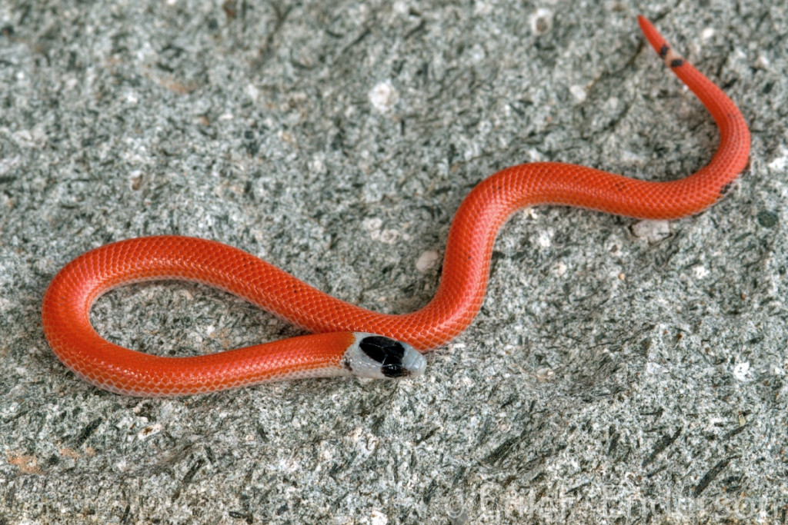
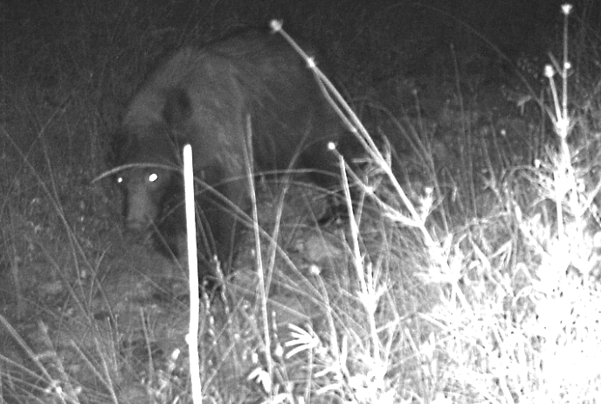
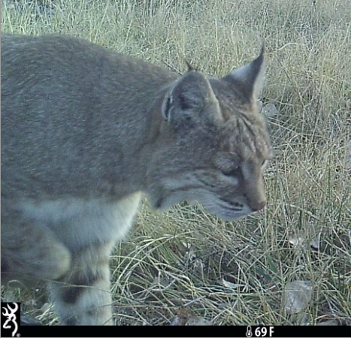
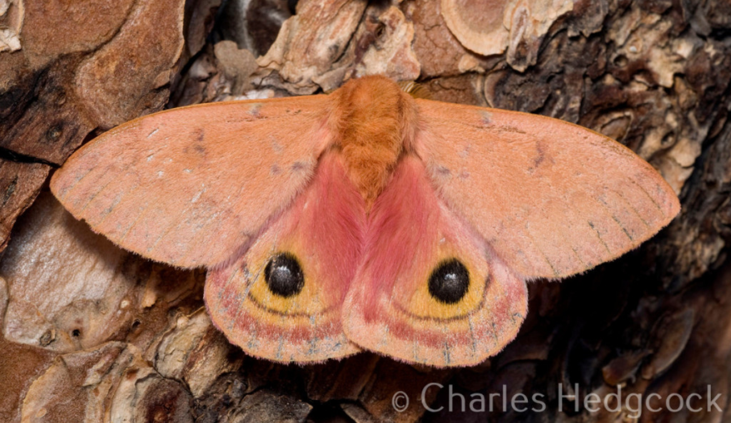
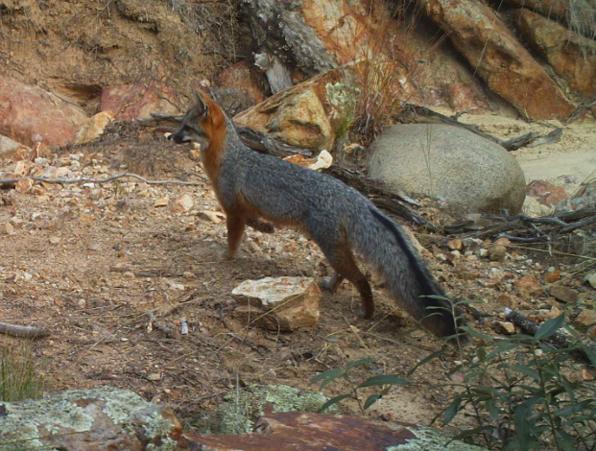
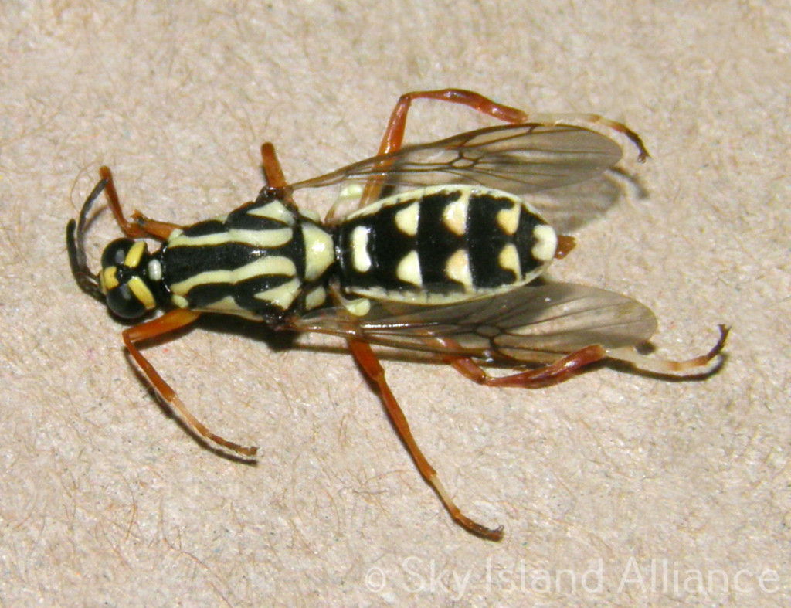
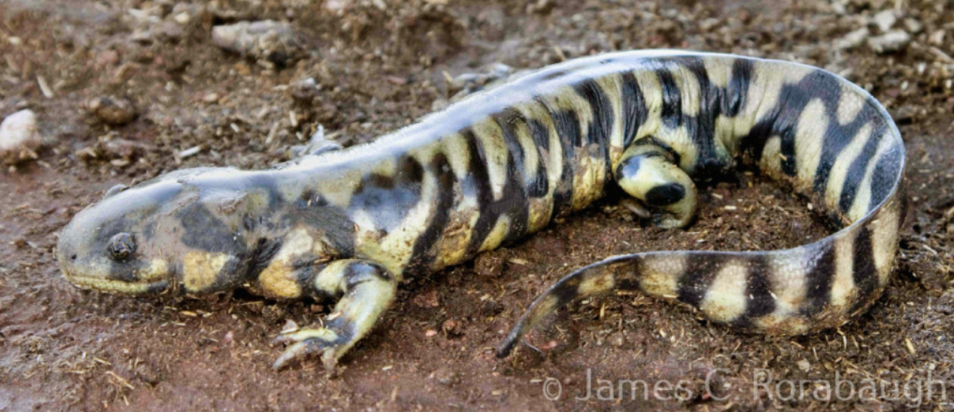
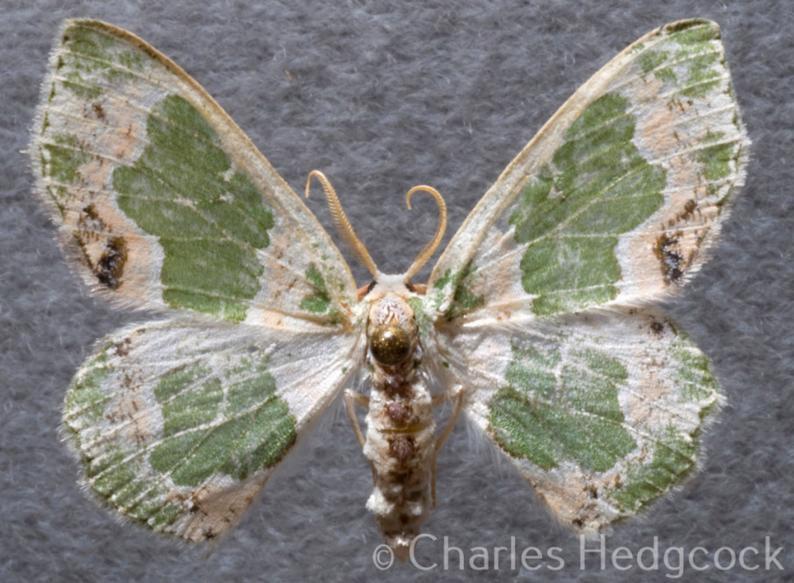
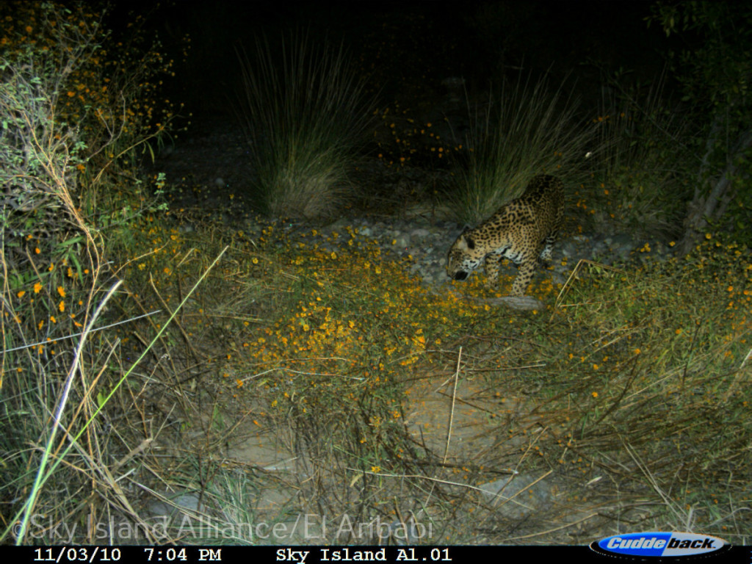
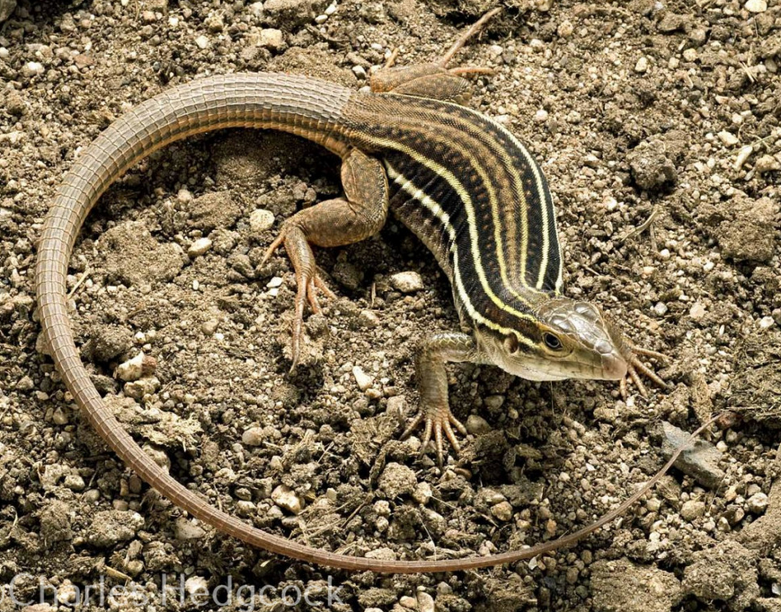
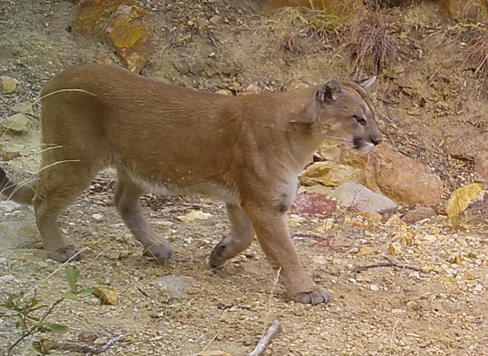
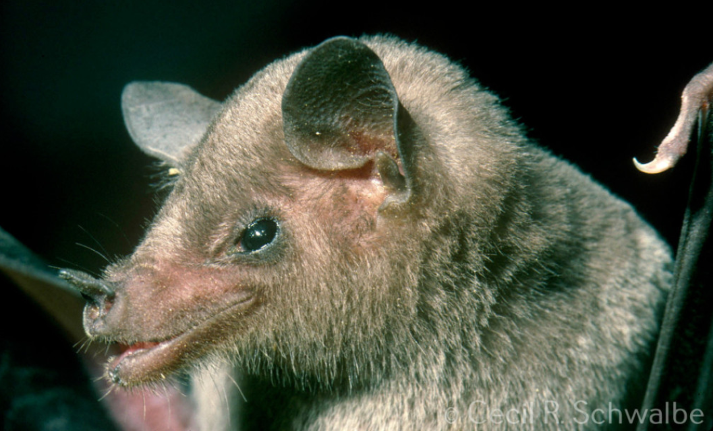
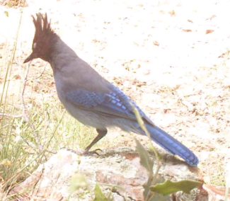

Slide 4
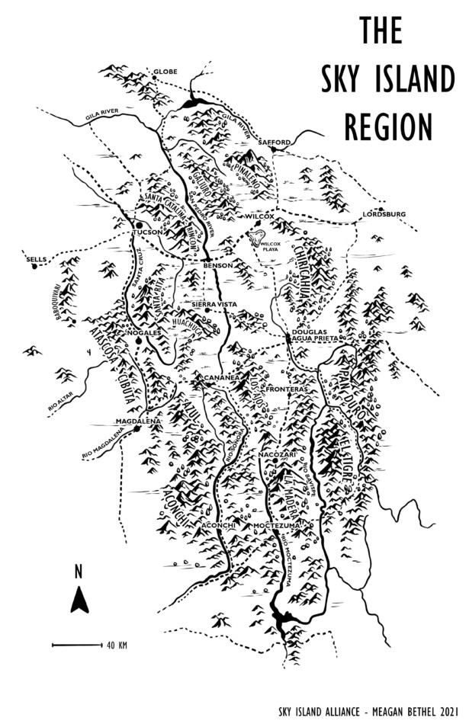
Undefined by national borders
It is important to recognize that the human-made USA-Mexico borderline crosses this area of the natural landscape. Contentious and volatile politics have resulted in a physical steel fence being built, harming not only human populations, but also animals, insects, and even plants.
Endemic and migratory species need access to the mountain region, and many traditional routes have been interrupted. Sky Island Alliance actively advocates for the halting of border wall construction, and the removal of currently-standing barriers.

Slide 5
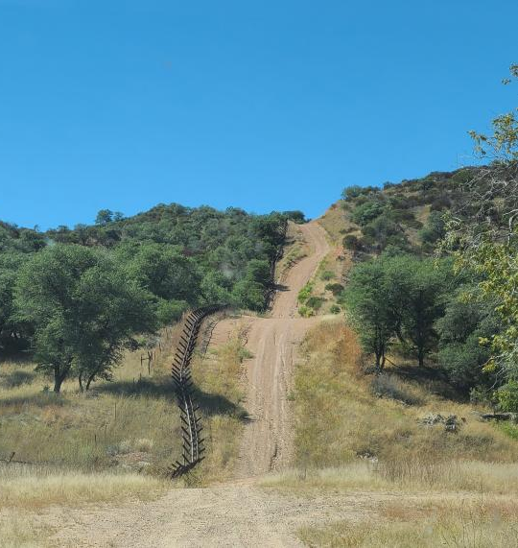
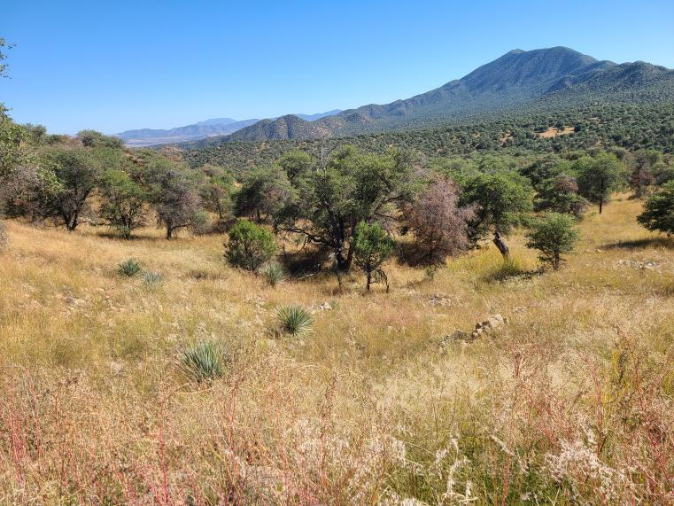
The U.S-Mexico border (not walled).

Slide 6
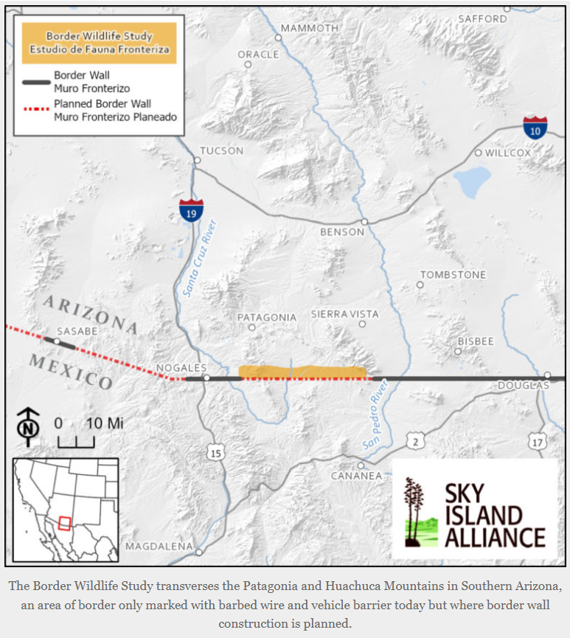
Border Wildlife study
One of SIA's current projects is the Border Wildlife Study, which is designed to capture a photographic database of Sky Island species that live around the border. Currently, 62 motion-activated cameras capture photos and video in around 60 square miles of Southern Arizona and Northern Sonora.
They have documented the many species that live on the land proposed to be developed for border wall construction. Migratory species use this area as a corridor, while other animals may be chased away by the light pollution the wall would bring.

Slide 7
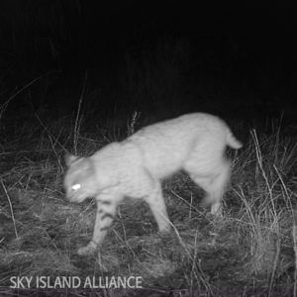
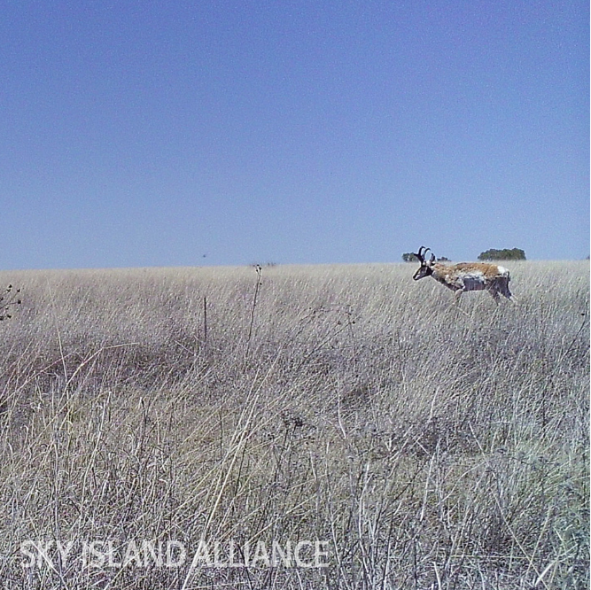
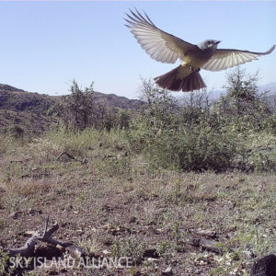

Slide 8
The cameras have captured some truly amazing shots of wildlife that one might even think came from a professional photographer.
Over the past few months, I've been collecting my favorites. These are images that struck me in the moment and illustrate the incredible biodiversity of the region.

Slide 9
White-tailed deer

Slide 10
Coyote and cattle

Slide 11
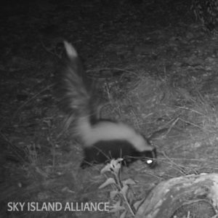
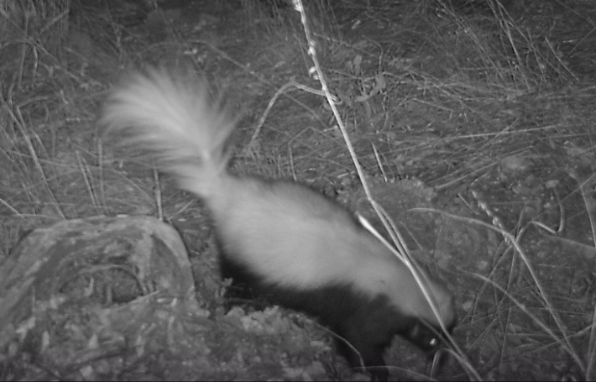
Hooded Skunk
Western Spotted Skunk
The 4 skunks of the Sky Islands
Striped Skunk
Hog-nose Skunk

Slide 12
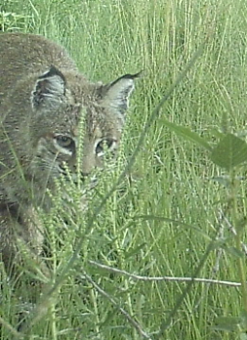
Bobcat

Slide 13
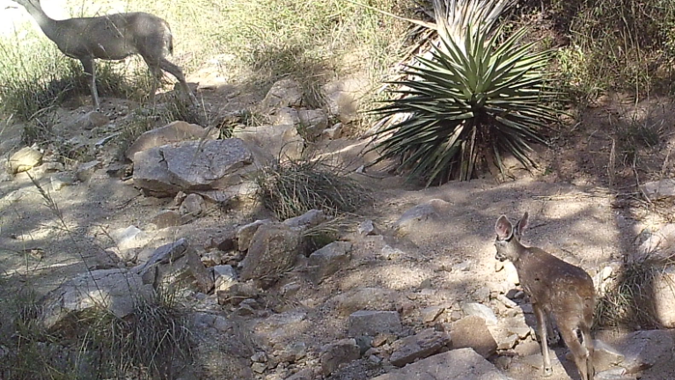
White-tailed deer

Slide 14
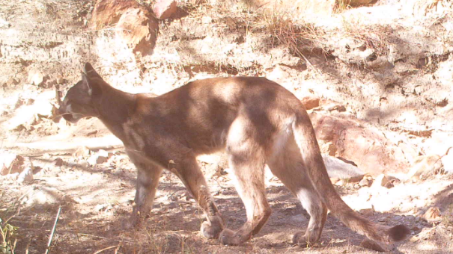
Mountain Lion

Slide 15
Stellar's Jay

Slide 16
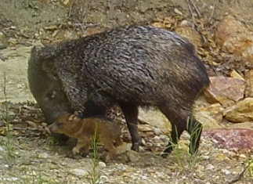
Javelina

Slide 17
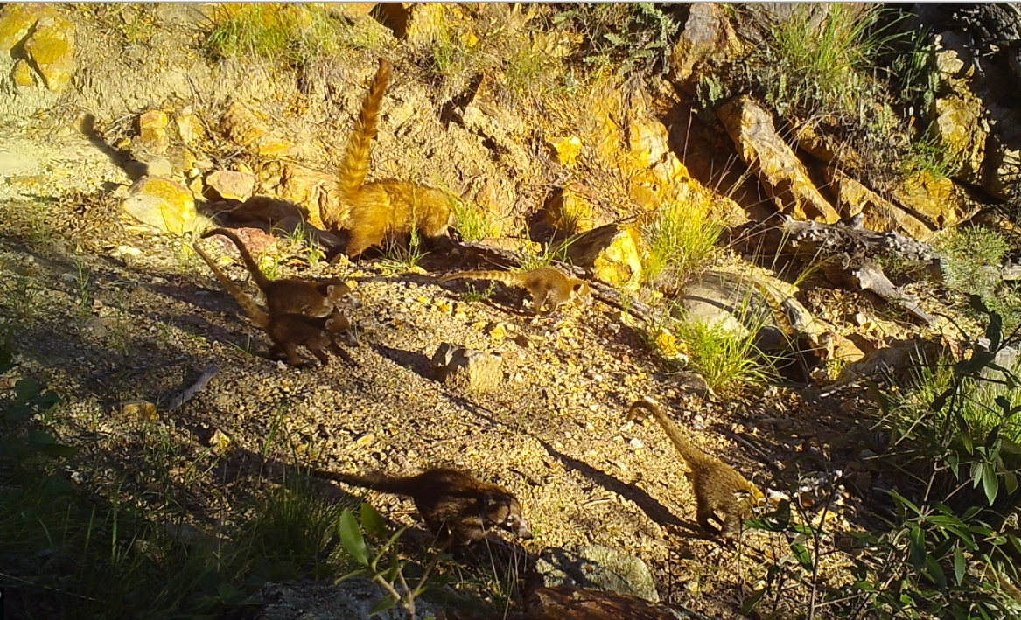
White-nosed Coatimundis

Slide 18
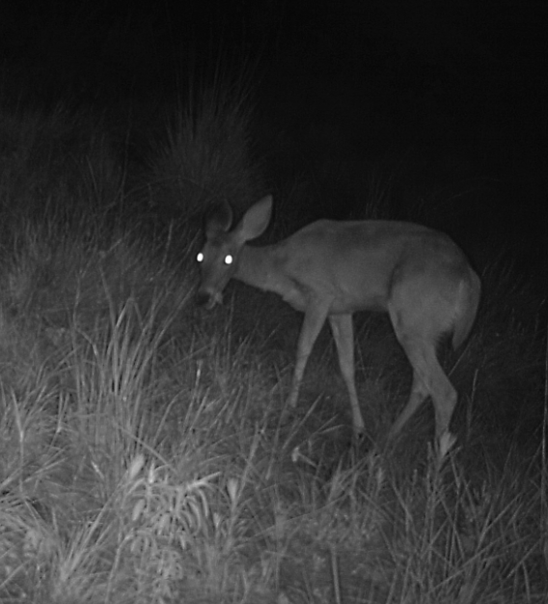
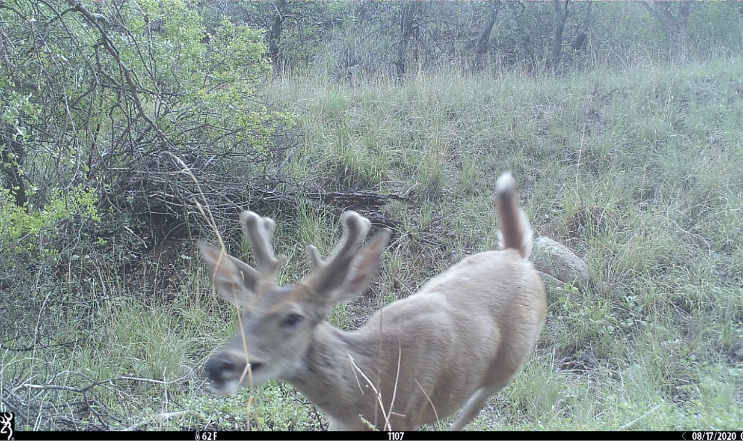
Honorable mentions

Slide 19
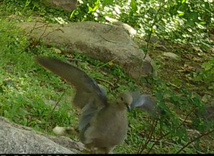
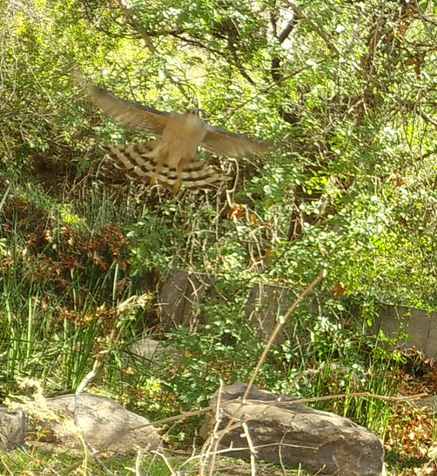
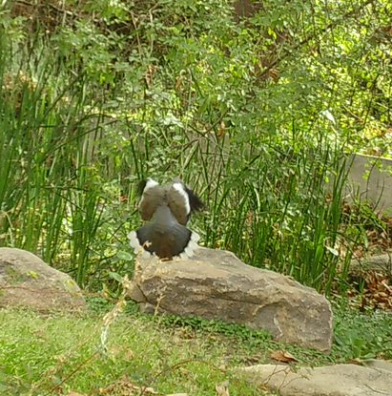
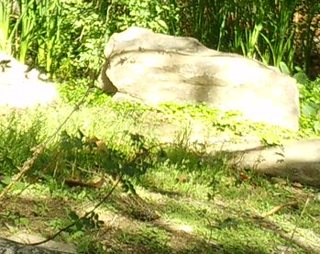
Campus Camera
z
Sonoran Underwood Garden at CAPLA
10 weeks of monitoring
1400+ pictures in all
8 total species captured on camera
I'd expected more urban wildlife to use this space, since it’s a good re-creation of the natural Sonoran desert riparian habitat. The garden may be too urban-ly remote for more species to locate. Other disturbances may come from the fact that this area is frequented by humans, right next to a busy parking lot, and bordered by CAPLA, which is in turn bordered by Speedway Blvd., a notoriously busy street.
Leopard frogs are very hard to see

Slide 20
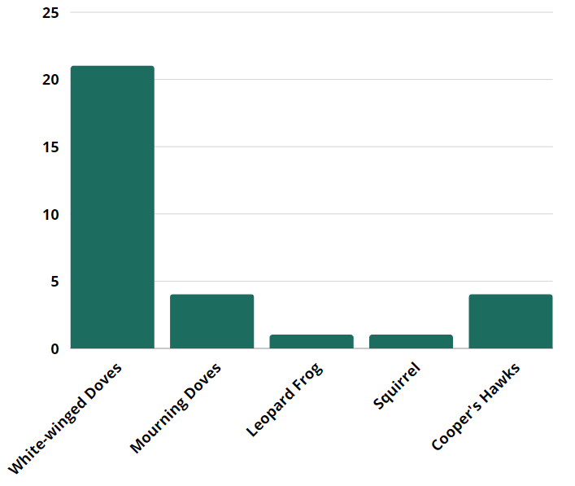
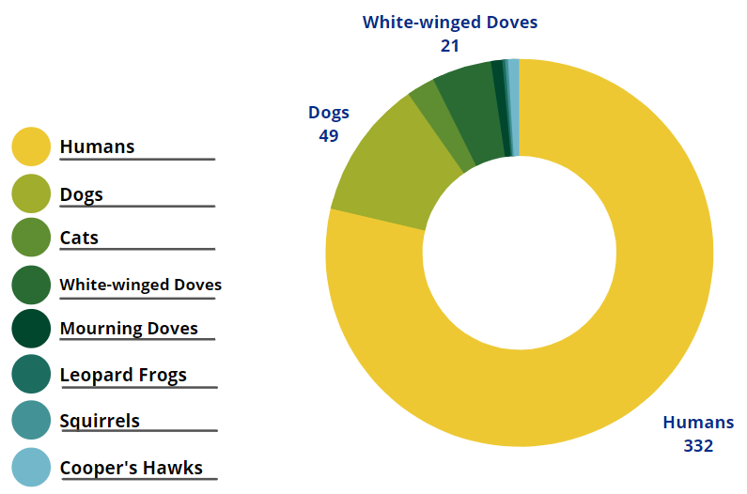
Breaking down the data:
Species Spotted
Urban wildlife

Slide 21
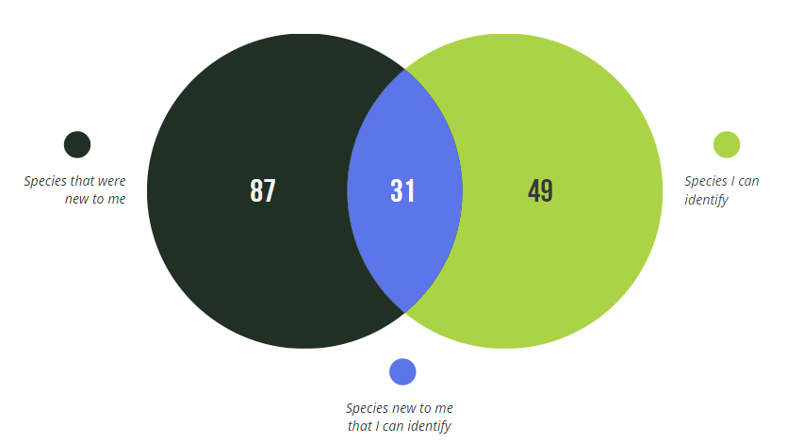
My animal identification skills improved greatly:

Slide 22
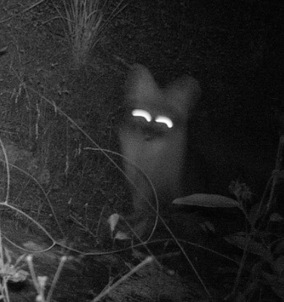
Thank you
And special thanks to The Earth Grant Program and AIRES, Sky Island Alliance; to Leona, Meagan, and everyone else who helped me get the most I could possibly get out of this experience.
Photos from Sky Island Alliance, FotoFauna participants, and credited photographers.

